Slide 1
The Story of Elmwood
1830-2012

Slide 2
Native Americans
The two big Illinois Indian tribes were the Algonquins and the Iroquois.
They inhabited this area when the first settlers arrived.
Other tribes- Tamaroas, Michigameas, Kaskaskies, Cahokias, and Peoria

Slide 3
Newburgh
Newburgh was a town that was founded, but disappeared. It was 1 mile north and ¾ mile west of present-day Elmwood.
It had 3 streets, 6 blocks, and 38 lots.
A schoolhouse was built in 1841.
A doctor, Silas Howe Washburn, arrived in 1849.

Slide 5
Harkness Grove
Harkness Grove was located Southeast of Elmwood.
Isaac Harkness was the first settler in the area (1830).
Another settler that came later was Isaac Doyle(1833).

Slide 8
First Settlers of Elmwood
Several early settlers of Elmwood were abolitionist.
The 1st settlers in Elmwood were John and Lucy Ewalt and their four sons.
They arrived May 1, 1831, from Edgar County, Illinois.
Some later settlers were from Ohio, Pennsylvania, and New England.

Slide 9
William J. Phelps
Arrived in Peoria on September 30, 1834
Married 20 days earlier
His son, William E., was the second child born in Elmwood Township (1835)

Slide 10
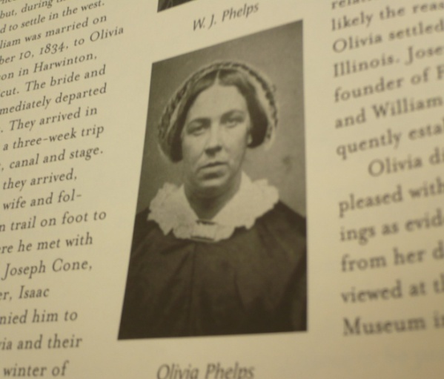
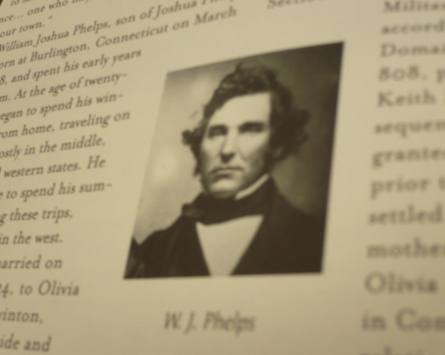
Phelps Story
The Phelps were some of the early settlers that came to Elmwood. The Phelps also helped with the Underground Railroad.

Slide 11
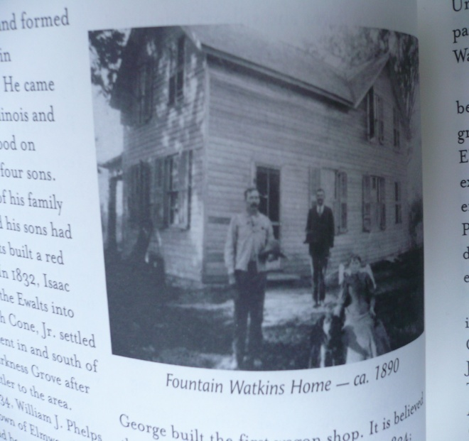
Fountain Watkins
In 1837 Fountain Watkins
came to Elmwood.
Fountain Watkins also
helped runaway slaves. He
once had a runaway slave
come to his house in broad
daylight. Then he dressed the
slave up in his wife’s clothes & took him on horseback to the next safe hideout.

Slide 12
Establishment of Elmwood
Mr. Phelps started planning the future town of Elmwood and selling lots in 1852.
On April 6^{th,} 1852, during an annual town meeting, a vote was taken for township organization.
In 1854, Mr. Phelps laid out the town of Elmwood.

Slide 13
Churches
The Congregational church was suppose to be built on 16f 4 block Q.
It was started in 1854 and finished 2 years later in 1856.

Slide 14
Railroad
Hudson River Railroad was secured in August and September of 1851.
By 1855, Peoria and Oquawka Railroad was running through Elmwood.
The Hudson River Railroad reached Elmwood in February, 1856.
In 1865-1866, parties came from Elmwood to offer to run their road through Elmwood.

Slide 15
The Newspaper
Newspaper used to be called Elmwood Chronicle in the 1860s.
Olivia Phelps wrote about the assassination of Abraham Lincoln on April 14th, 1865.

Slide 16
Other Info
The farm that Daniel Hurff bought in 1860 is now our Country Club.

Slide 17
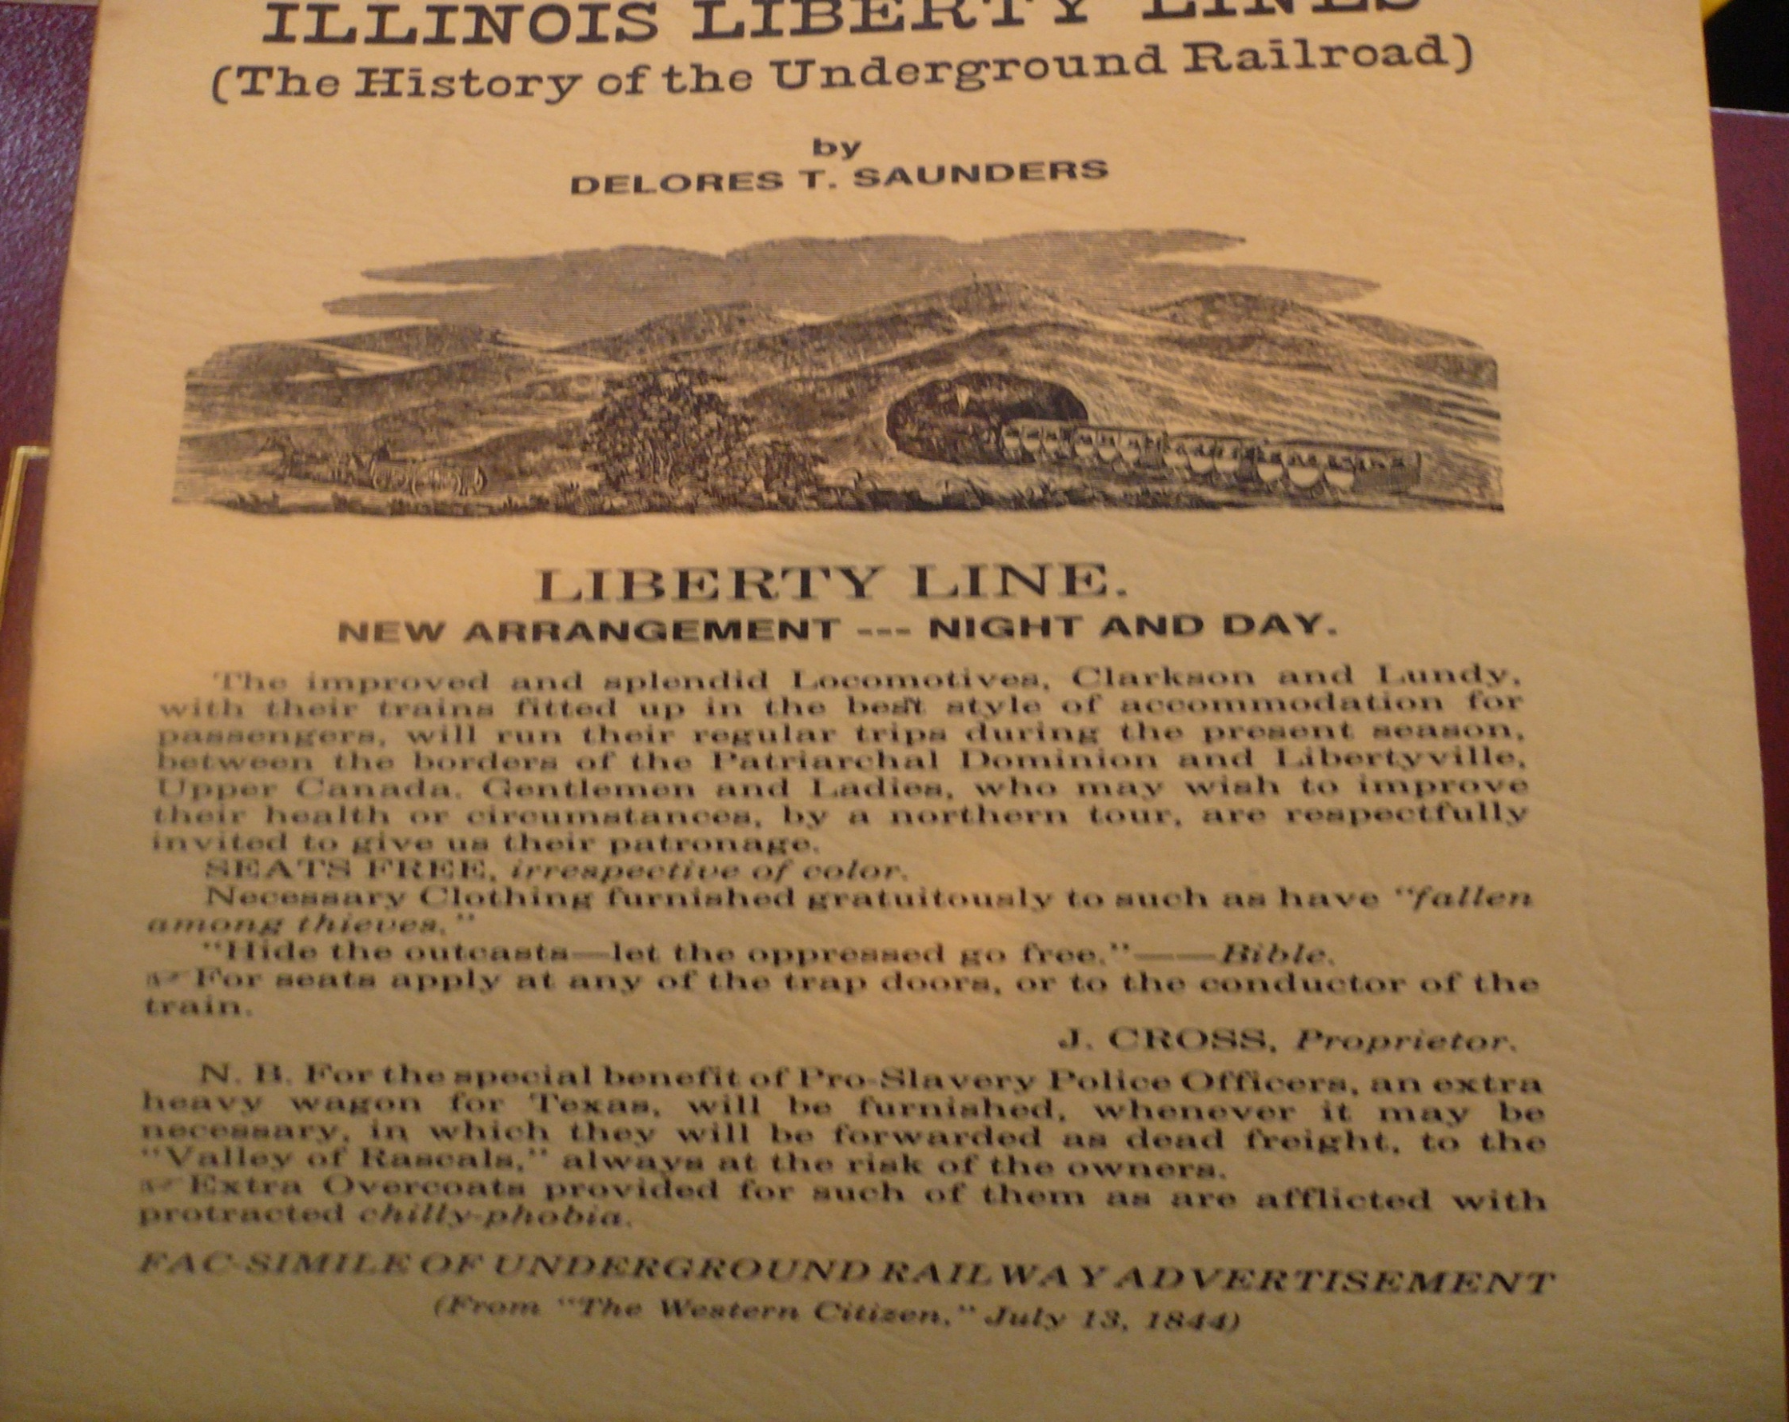
The Underground Railroad Liberty Line
The Liberty Line that ran through Elmwood originated on the Mississippi River at Quincy.
It made its way to Farmington then Elmwood.

Slide 18
Fredrick Douglas came to Elmwood in 1870.

Slide 19
Town in 1870

Slide 20
Police
July, 1875: First violation noted
July 15th 1875: Payment for police service first recorded
December 1877: Night policing began

Slide 21
Laws Of The Town
Laws Ordinance #4 – No women can complain about the use or bagging of liquor
Ordinance #10 Section 1 – No disturbing any peace of anything using instruments, of any kind, making loud noises, yelling fire, or watch
Ordinance #10 Section 3 – No dog fights do not encourage or gesturing of encouragement
Ordinance #10 Section 9 – You can not engage on Sundays, in the amusement or exercise

Slide 22
1883
August 10, 1883 – Notice is hereby given that all cows belonging to citizens within the corporate limits of Elmwood must be shut up at night

Slide 23
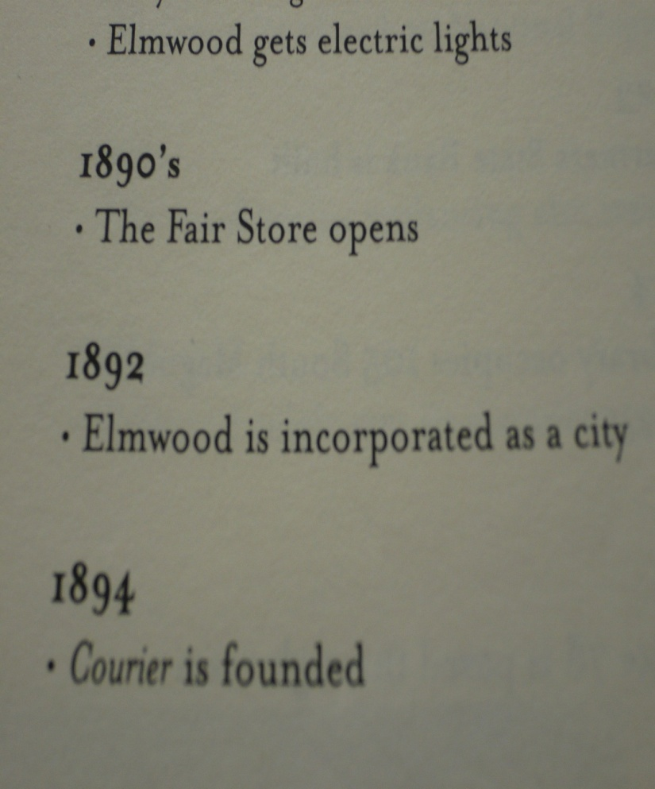
Elmwood
In 1892 Elmwood is incorporated as a city
In 1895 the first city
well was recorded

Slide 25
Fire in Downtown Elmwood
A fire in 1897 destroyed several buildings in the Commercial Block.

Slide 26
Paving of Route 78
Route 78 was paved in 1925, along with the town. This helped to make an easier path to Peoria. The cost for the state was $400,000. It included new curbs, gutters, and sidewalks. Route 78 was also widened during this project.

Slide 27
Living in the country 1930-1949
No electricity
Had to travel to get and trade items
Had no mail service
Had to travel to get news and mail
Had to use horse drawn plow
Had no running water
Had no modern plumbing

Slide 28
Silver Cornet Band
In 1860 Lem Wiley was the finest cornetist in Elmwood and was the leader of the Silver Cornet Band when the war with the South began. When the war began Wiley and his band members enlisted. Soon Wiley formed a band and it retained its former name until it returned to Elmwood after the war.

Slide 29
1973-’75
1973- Sewage disposal plant is completed
1973-B.Y.E is organized
1974-Sweetwater ball diamonds are created
1975-New firehouse on North Magnolia St. is dedicated

Slide 30
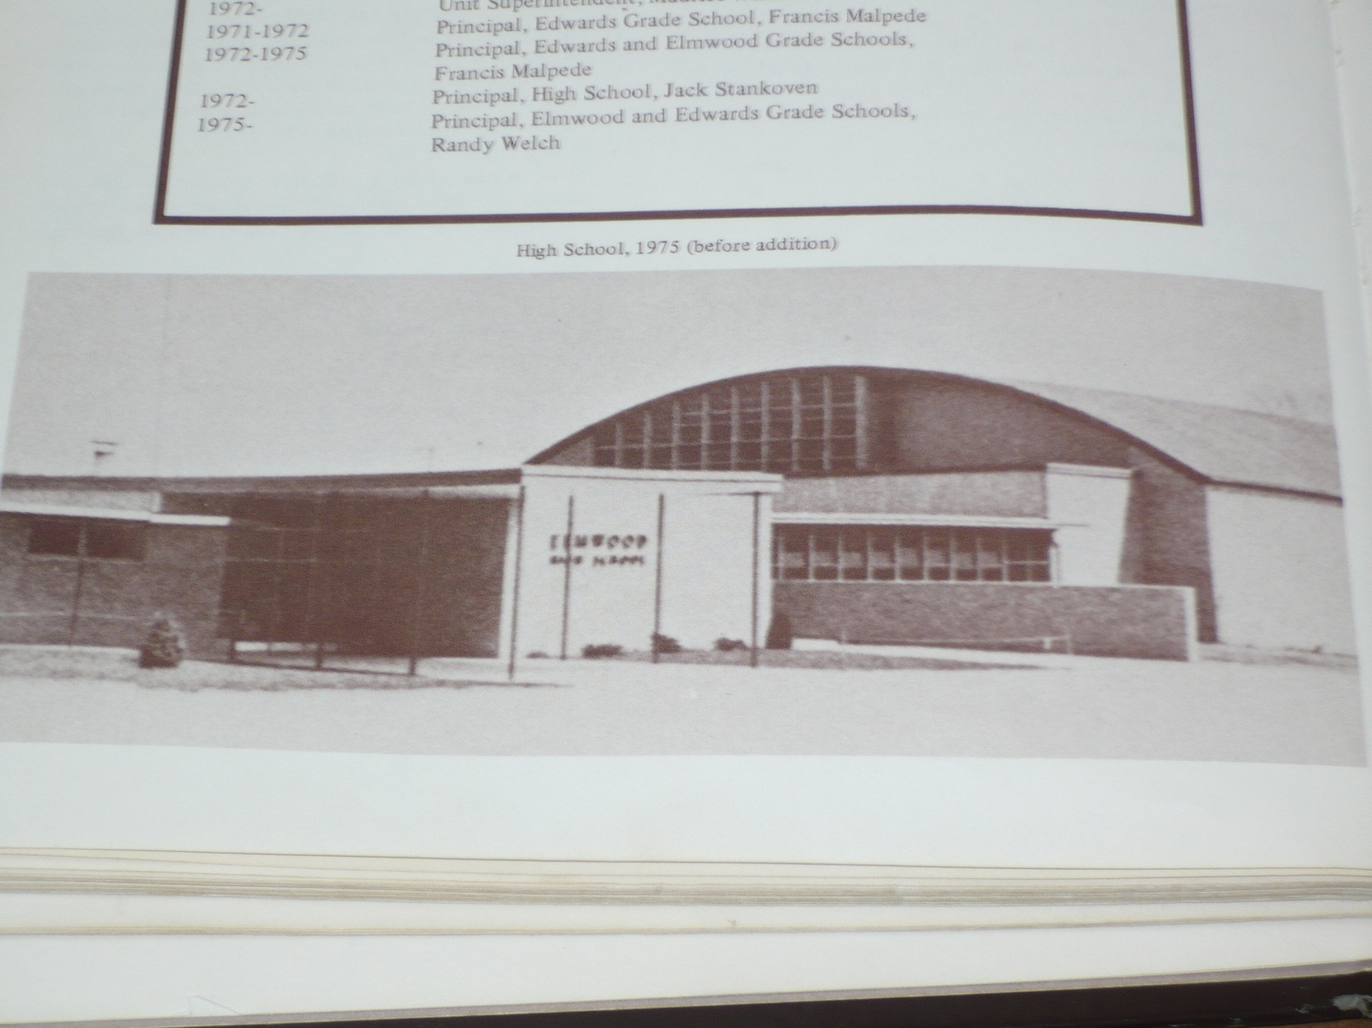
1975-’76
1975-Railroad station is torn down
1976-Elmwood’s celebrated the nations bicentennial by writing a history book of Elmwood

Slide 31
Late 1970s
1979- Elmwood Blizzard

Slide 32
1980s
1983- B.Y.E receives governors hometown award
1985-Veterans memorial is dedicated to Elmwood's Cemetery
1986- Congregation church merges with the Union Church in Brimfield
1988-Strawberry festival was started because of local strawberry farmers
1988- Veterans memorial township cemetery is dedicated

Slide 33
1990

Slide 34
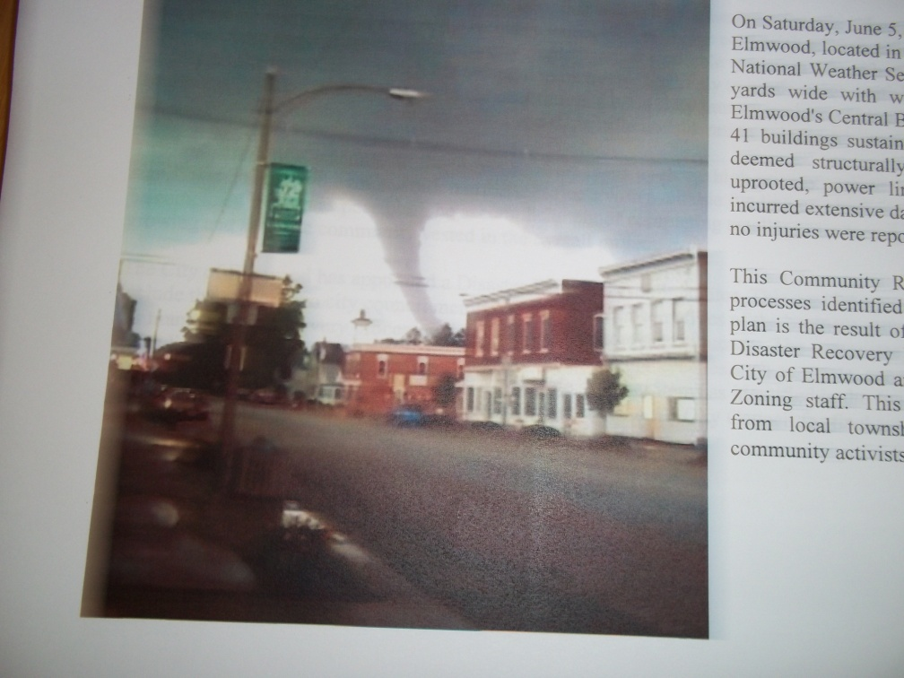
Tornado
A tornado hit Elmwood, IL June 5, 2010.
The tornado was a EF-2. It was 50 yards wide with winds up to 130 mph.

Slide 35
Recovery of Elmwood
There were several businesses and services that needed repaired after the storm.
Five buildings had to be demolished.

Slide 36
Library of Congress
During the 2011-2012 school year, the Junior High students gathered primary sources and documented the history of their town.
With the help of Bradley University, this will be published in the Library of Congress.

Slide 43
Phelps Barn

Slide 44
The Phelps Barn was built in 1842.
It was a stop on the Underground Railroad.

Slide 45
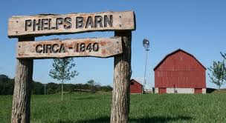
Phelps Barn Reconstruction

Slide 46
A group of people came together to restore the barn for a historic site.
Timber Framers Guild helped with the renovation.
The barn rafter plates were 40 ft long and 8 in square. Each beam was weighing more than one ton each. The wood in the barn was made of white oak, and ash.

Slide 47
The original creators of the Phelps barn made the beams so they fit together without using nails. The new builders would repair the barn so it doesn’t fall on itself.
The renovation was June 15-28th of 2003.
Rick Collins was the head of reconstruction.

Slide 48
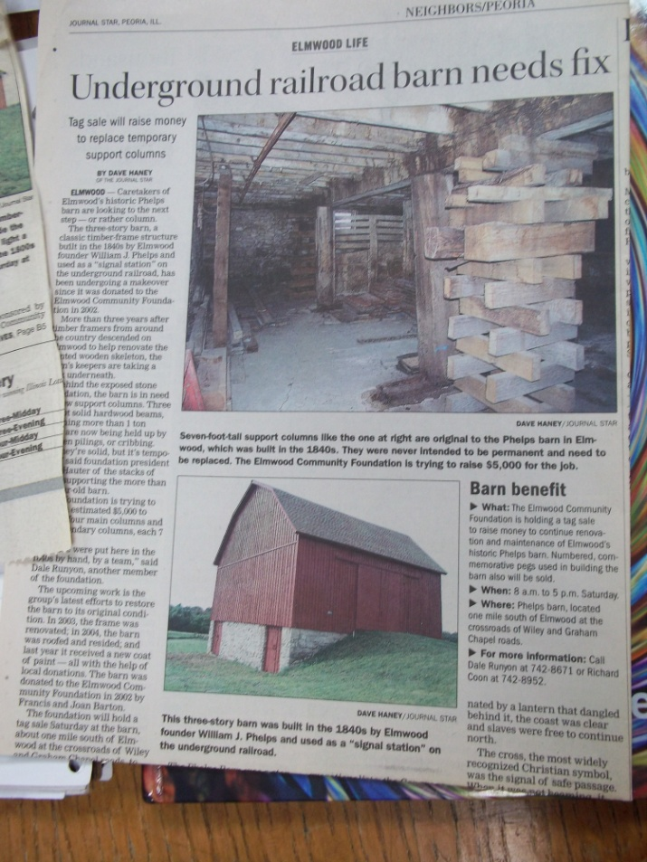
The barn was a link to the Pioneer Past of Illinois. It was put together by pegs and beams.

Slide 49
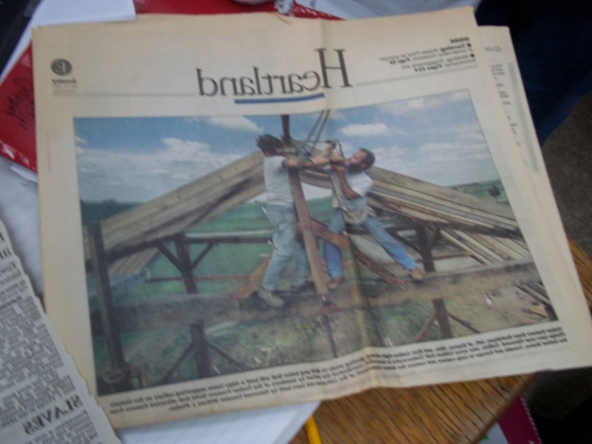

Slide 50
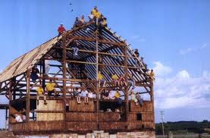
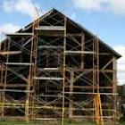

Slide 51
Lorado Taft

Slide 52
Lorado Taft was born on April 29,1860
Lorado Taft's parents were Don Carlos Taft and Mary Lucy Foster
Don Carlos Taft And Miss Anna Summers were pioneer teachers
Ada Bartlett and Lorado Taft were married in Feb 1895
His brother Florizel was born in Elmwood in 1862

Slide 53
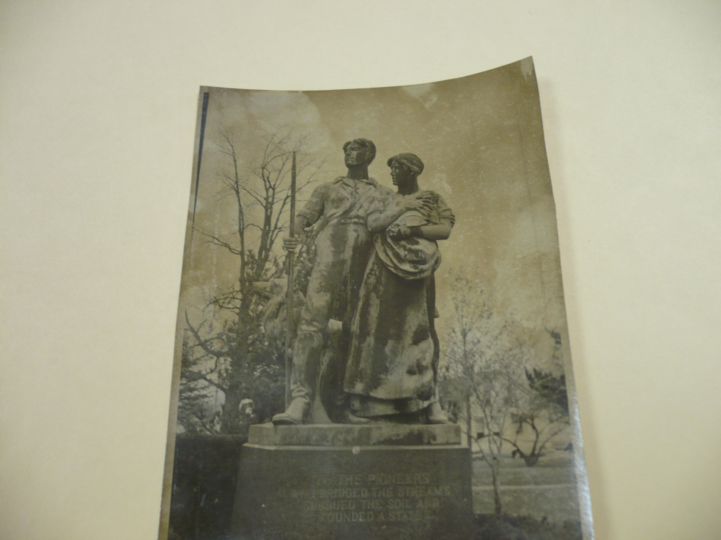
Dedication to Pioneer Statue
Lorado Taft built the Pioneer Statue. It took $15,000 to pay for this process. The statue weighed 3,500 lbs. and was 10 ft high. Mr. and Mrs. E.L. Brown donated $5,000 to help. By January 14, 1926 they only needed another $1,200. Kids did errands for dimes to fill their golden ruler which held 12 dimes.

Slide 54
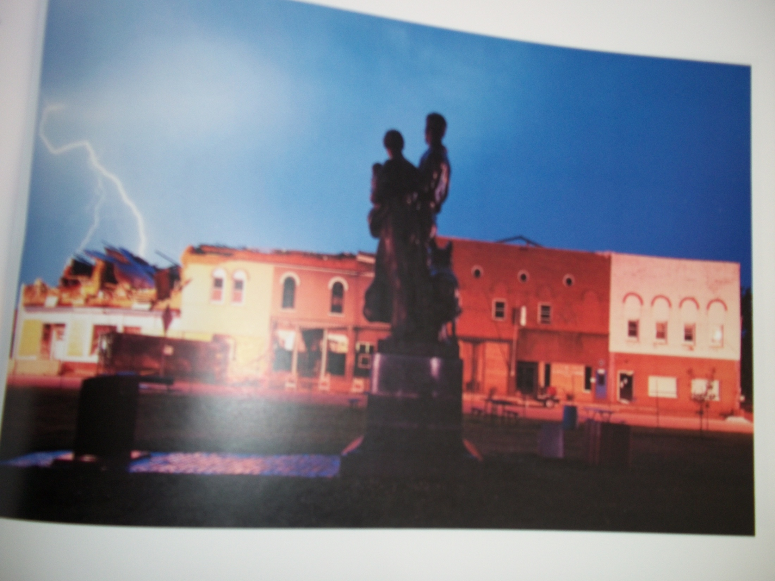
Harry McFall, Leroy Morrison, Ralph Bacher, Earl DeFord moved the artwork to the truck and put it on the base. Then Harry McFall Jr. climbed to the top, and put the drape on. At 1:30 the Elmwood Band Concert started. Emily Taft unveiled the statue at 2:20.

Slide 57
Lorado Taft
Lorado Taft suffered a stroke 8 days before his death. He died on Friday October 30, 1936 shortly before 9:30 in his sleep. His ashes were scattered in the Elmwood Town Cemetery.

Slide 58
In 2001, the Pioneers was placed on the National register of Historic Places by the U.S Department of the Interior.
2004 pg. 107

Slide 59
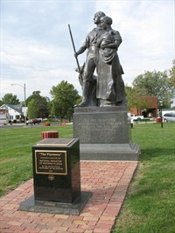

Slide 60
School

Slide 61
First Schoolhouse
It is believed the first schoolhouse was built in 1834.
It was started by Justice Gibbs.
Daniel Fash was one of the teachers at the school.

Slide 62
Elmwood Academy
The Elmwood Academy was opened in 1854.
The first tax supported public school was built in 1866.

Slide 63
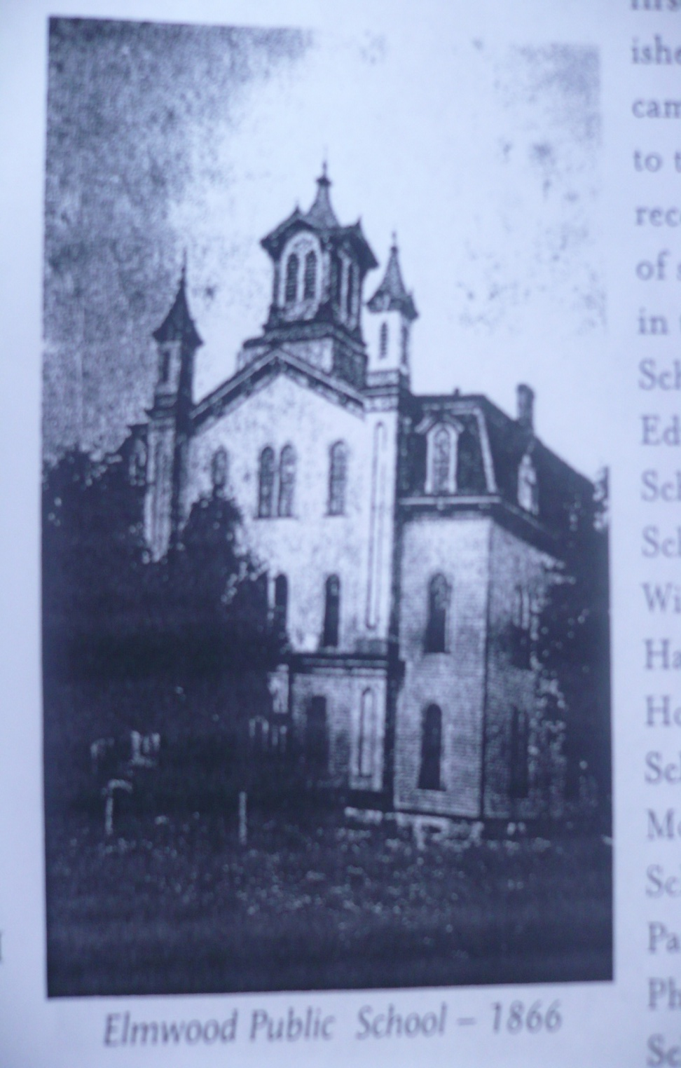

Slide 64
First Graduating Class
Elmwood school system was formed in the early 1860s.
There were 2 high school teachers and Ms. Welles was the assistant principal.
September 1870, the school was so full that they added onto it.
June 6th ,1872 the first class graduated from Elmwood.
The first graduating class had 11 people in it.

Slide 65
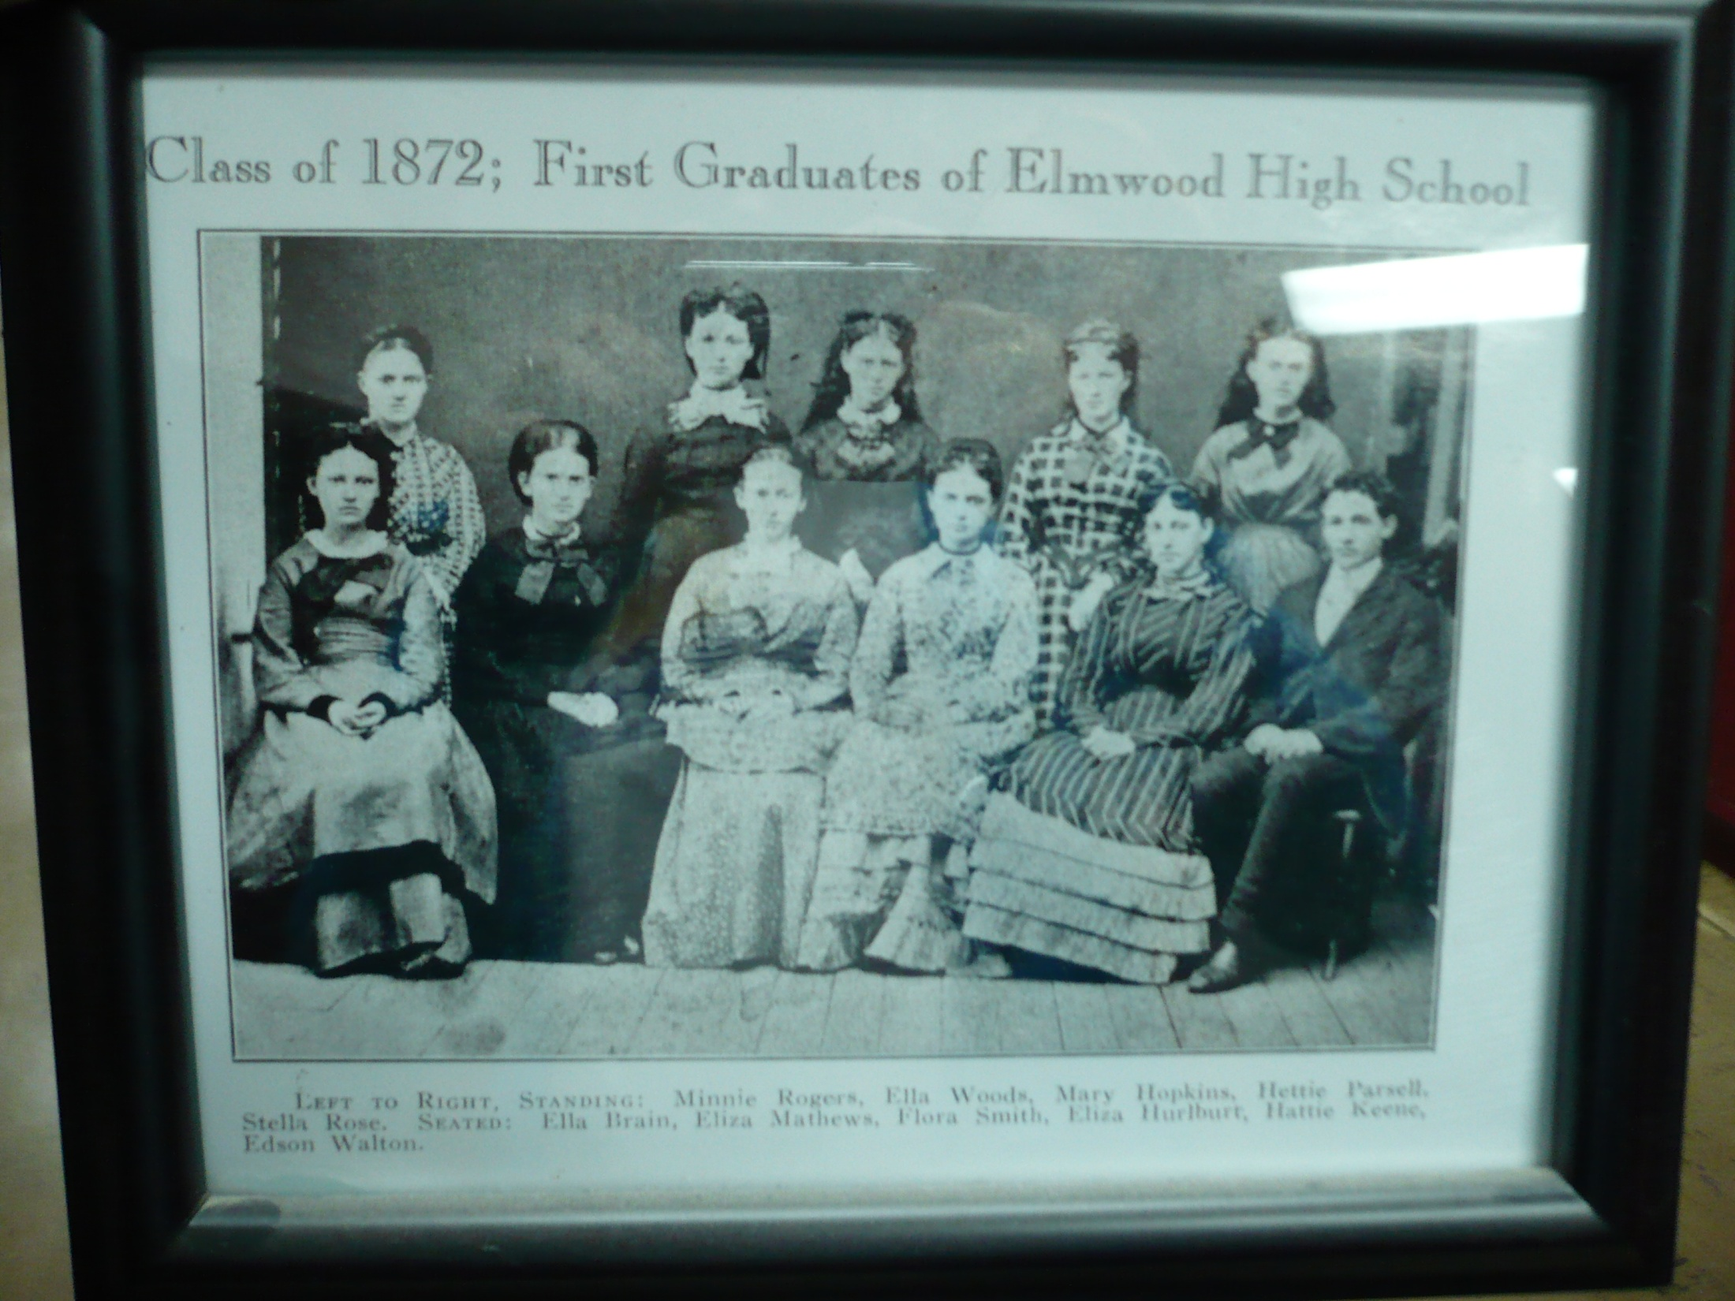

Slide 67
School Fire
In 1895 the school in Elmwood was destroyed by a fire.
There were two fires; the first one was caused by a bird’s nest in the bell tower caught fire and then caught the school on fire. Luckily they caught it in time to put it out.
The second fire was caused by a furnace’s coal’s sparks got on the roof and they did not have the right equipment to put it out, so it burned down. They ended up getting teachers, students, books, and desks out.

Slide 68
New School
A new school was built in 1896 after the fire burned the old one down.
It did NOT have indoor plumbing and one of the duties of a janitor was to make sure the outhouse was kept clean.
The drinking water was obtained from a well in the northwest corner of the building.
Basketball and football were the first sports in the new school.
The school cost about 28,000 dollars.

Slide 70
Course of Study 1902-1903
Elementary courses- Reading, spelling, arithmetic, geography, history, writing, physiology, music, drawing
High school courses-Algebra, Latin, history, physiology, physical geography, English composition, literature, rhetoric, zoology, botany, physics, chemistry, plane geometry, solid geometry, English grammar, arithmetic, music

Slide 71
The Ulmus
The first Ulmus-1913- was named because of the trees in Elmwood. The Ulmus is Latin for “The Elm”.
It states in the book that the school mascot was called the Trojan because the word Trojan came from the Romans.

Slide 72
Grade School Gym
In 1928, tax payers approved the construction of a gym to be located across from the school on the southeast corner of West Hawthorne and South Althea Street. It had a regulation basketball court, a stage, dressing rooms, board rooms, kitchen and the cost of 32 thousand dollars. It was one of the only regulation gyms.

Slide 73
Grade School Gym continued
In 1929, after the gym was built, Elmwood was asked to host the sectional basketball tournament. The snow was so bad the teams had to stay in the gym for the night.

Slide 75
Closing of Country Schools
In the early 1950s, the country schools were closed because they were not able to provide services for the number of students enrolled.

Slide 76
New High School
The new high school was built in 1953 because of the need for space coinciding with the closing of country schools.

Slide 77
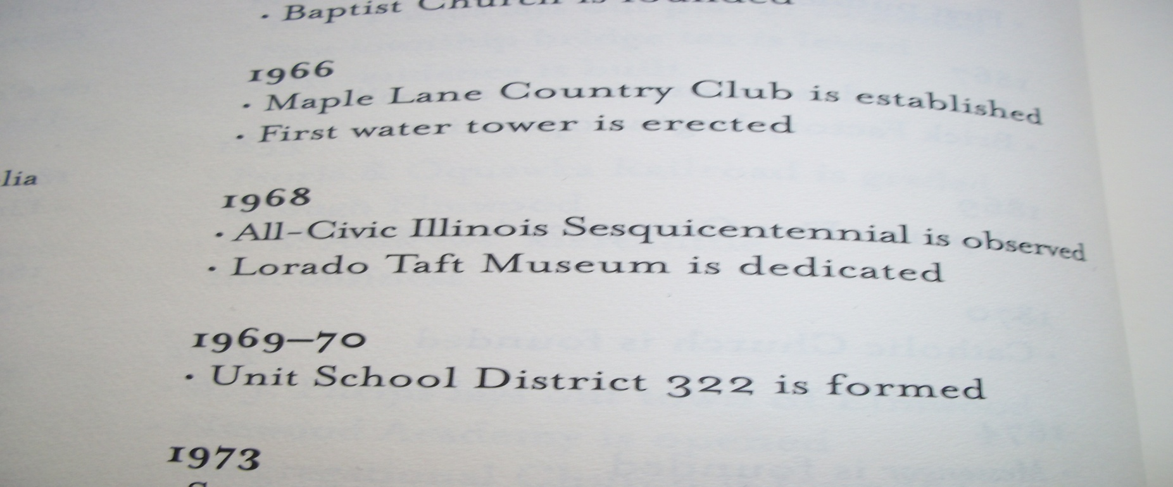
1969-1970- Unit School District 322 is formed

Slide 78
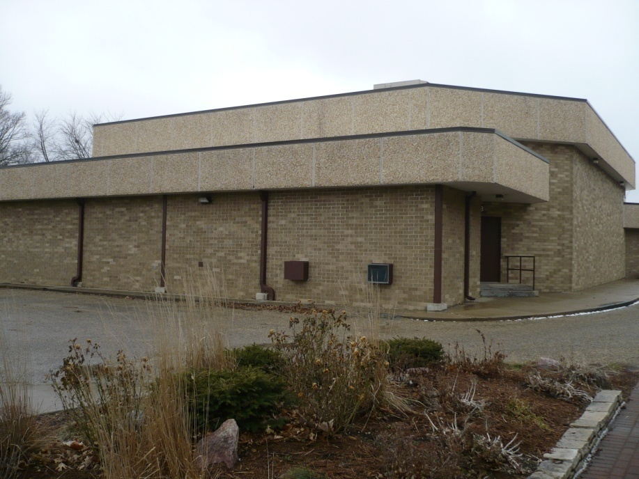
In the mid 1970’s, the Junior High unit and auditorium was built.

Slide 79
A new grade school Info from Mrs. Carlson
The Elementary School was completed in 1993.
The building was built using life, health, and safety bonds.

Slide 80
Wars

Slide 81
World War I
In the winter of 1917 and 1918, WWI was raging. Sadness swept across Elmwood as homes lost loved ones and dear friends.
Elmwood organized its branch of the Red Cross in 1918

Slide 82
Vietnam War Veterans
-Kinney Miars Interview

Slide 83
Desert Storm
Brian McKechnie

Slide 84
Businesses

Slide 85
Early Businesses of Elmwood
Coal was discovered in 1838 on land that belonged to W. J. Phelps.
Jacob Wills started a Blacksmith Shop near the Ewalt home in 1840.
William George built first 1st wagon shop.

Slide 86
Early Businesses continued
Isaac Harness started the Cider business.
William Phelps opened the first bank.
Captain Joseph found some land and selected a site on the Kickapoo to build the mill.
Luzerne Bartholomew had a meatpacking business.

Slide 87
Post Office
Mail was originally brought from Farmington about twice a week.
Later, William J. Phelps became postmaster in 1847 and the mail was stored in a cherry desk made by Isaac West.

Slide 88
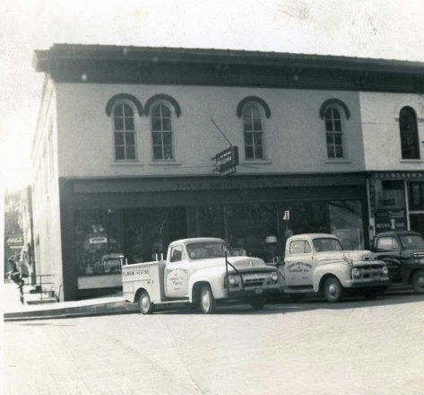
Business 1870-1889
Staples & Fancy Groceries
Wagon & Carriage Making
Elmwood Paper Mill Manufactures
Bradshaw & Caldwell Dealers in Hardware, Copper and Tin Ware and Stoves
Edson Smith & Sons Hardware since 1885

Slide 89
In 1890’s the Fair Store opened
In 1894 Couriers Drug Store is founded

Slide 90
Palace Theater
The palace theater first opened in 1913. It started off with still pictures and quiet music. It also had current news. Next, they improved to “movies” because the pictures moved therefore being called movies. The owner of the theater made homemade popcorn for the people to eat during the movies.

Slide 91
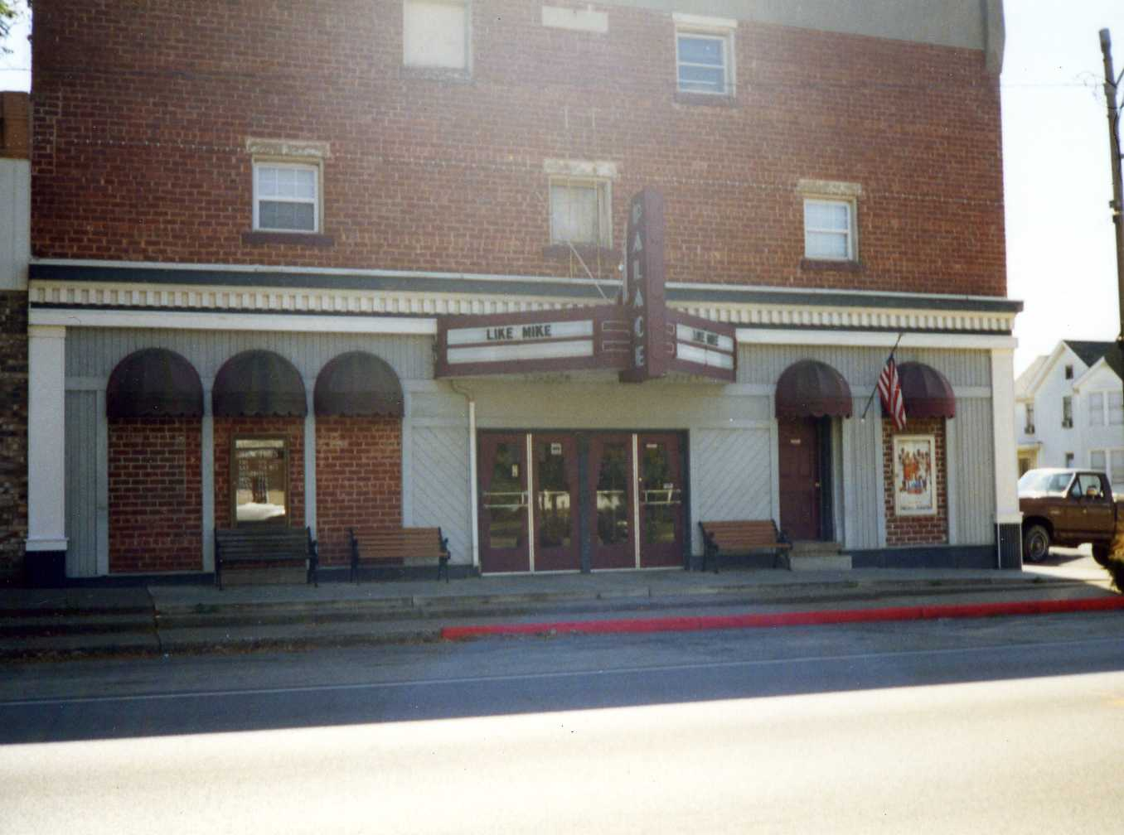

Slide 92
Strip Mining Coal
Strip Mining Coal developed in three areas, and occurred locally from the South of Elmwood to the West of Middle Grove.

Slide 94
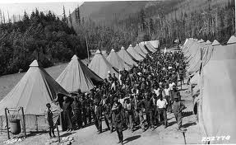
CCC Camp
Civilian Conservation Core Camp- built for men who needed work and training during the Depression
It was located on Lilac south and east of the railroad
The workers were paid $30 a month.
$25 were sent to their families and they kept $5 for their personal use.
There were only men that worked at the camp.
The typical CCC enrollee was a U.S. citizen, unmarried male, 18 to 25 years of age.

Slide 95
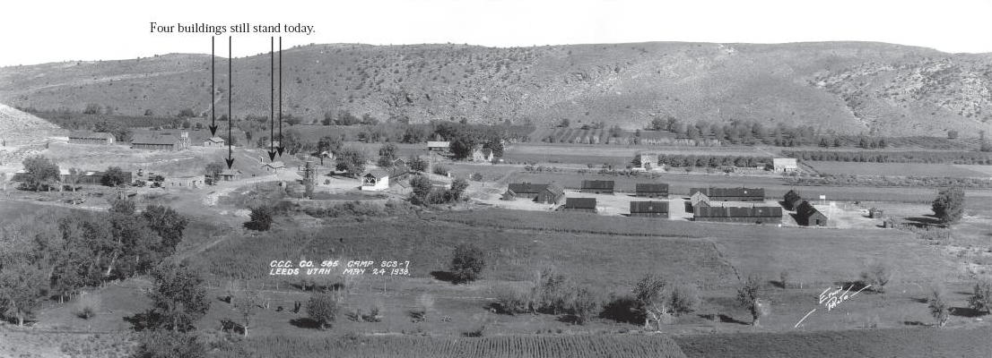
Each enrollee volunteered upon passing a physical exam and/or a period of conditioning, was required to serve a minimum of 6 month period with the option to serve as many as 4 periods, or up to two years if employment outside the corps was not possible.
Enrollees worked 40 hours a week over 5 days, sometimes Sundays and Saturdays if poor weather dictated.
The war veterans would recuperate and get jobs in the Civilian world South of the railroad tracks.

Slide 96
Business
The Whitney Law Office was built the Fall of 1931.
The Elmwood locker service was built in 1941.
Elmwood Telephone Exchange was purchased in 1947.

Slide 97
Public Library
The school was the 1st “public” library because it was open to the public on Thursdays from 4 to 5 p.m.
It was completed in the early 1950s.
A house across from today’s library is what used to be the library.
The total cost was about $90,000.

Slide 99
Hotels 1950-1969
The Randolph Hotel was located on the southeast corner of the streets Magnolia and Hawthorn. The hotel was made up of two buildings. The buildings were J. B. Reed’s harness shop and Dr. Swisher’s house, which was the second house built in Elmwood at that time period.

Slide 100
The Daley Insurance Agency
The Daley Insurance Agency and Real Estate was established in Elmwood. It was established in 1968 when Bruce and Vivine Daley bought the Hugh Nixon Insurance Agency and changed it into The Daley Insurance Agency. The Daley Insurance Agency still stands today.

Slide 101
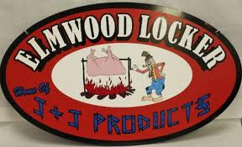
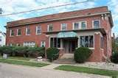
Business
Elmwood Locker
Dairy Station
Patterson funeral home
Fair Store
Hometown Hardware
Vicki’s Café
Elm Haven
Pg.94-102 of 1994 Elmwood High School Year book

Slide 102
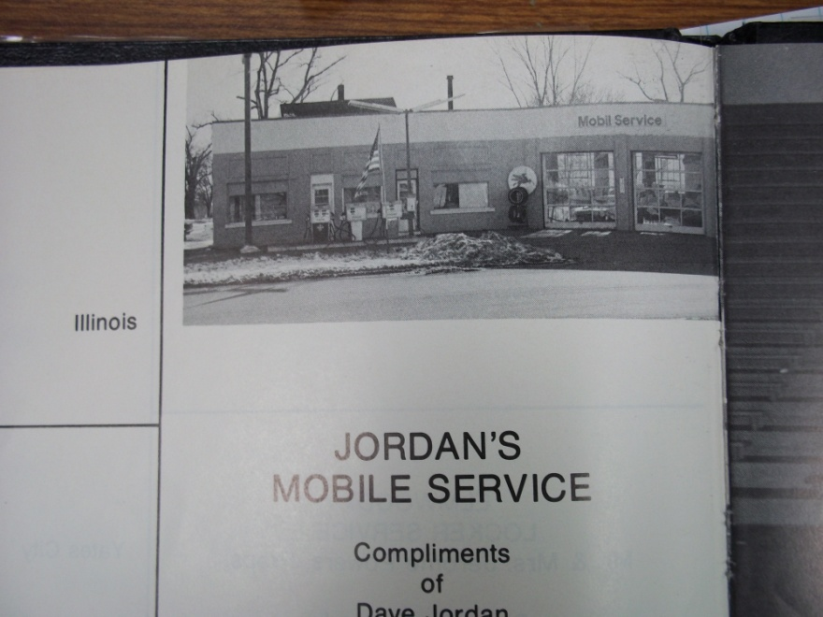
Business
Reynolds theater
Jordan’s Mobil
Tastee Freeze
The home shopper
Meyer’s mowing service
Reid’s Mobil
Information from 1998 Elmwood High School year book pg. 216-226

